Slide 1
Variables

Slide 2
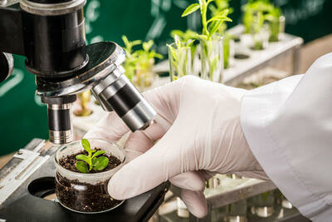
By the end of this Smart Lesson you should be able to:
Name the variables and constants in an experiment.
Identify the different kinds of variables we have in an experiment.

Slide 3
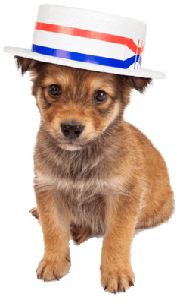
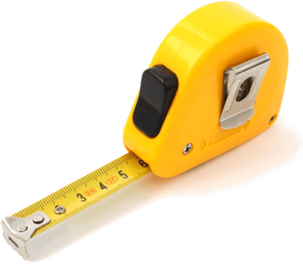
In science, variables are anything that can change.
These can be quantities, sizes or traits.
We often measure these changes.
Many things are variables.
Some examples are the number of cold days in a year, the size of puppies or the colour of flowers.

Slide 4
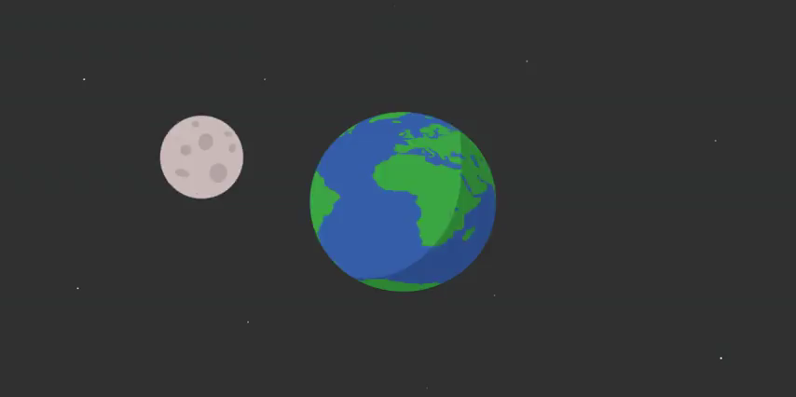
There are some things which never change.
These are called constants because they remain constant, no matter what happens.
For example, the mass of a carbon atom is constant because it always stays the same.
Other constants include number of hours in an Earth day-night cycle or the colour of elemental gold.

Slide 5
In scientific experiments there are three types of variables.
The independent variable is one that we deliberately change to cause some measurable effect.
The dependent variable is what we choose to measure. It is affected by the independent variable and is thus dependent on it.
The control variables are all the factors that we keep the same to stop them from interfering with our experiment.

Slide 6
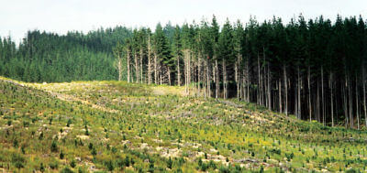
Let us look at an example of an experiment.
In this experiment, we are investigating how quickly sun-loving plants grow in different intensities of sunlight.
Our variables are the species of plant, the amount of sunlight and the rate (speed) of growth.
To make the experiment simple, we use one species of plant.
We use two levels of sunlight: direct and indirect.
We then measure the growth of each plant.

Slide 7
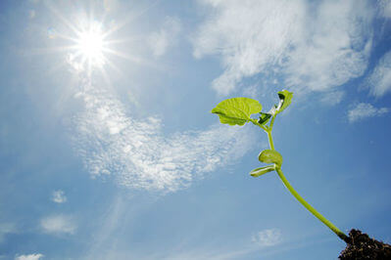
In this experiment, the species of plant stays the same. It is the control variable.
The rate of growth changes depending on what the level of sunlight is. Growth is therefore dependent on sunlight and is the dependent variable.
The sunlight is changed by us so we can measure its effect on growth. The level of sunlight does not change depending on the growth of a plant.
Look at it this way: the sunny area would still be sunny if there were no plants there at all. Sunlight is therefore independent of growth and is the independent variable.

Slide 8
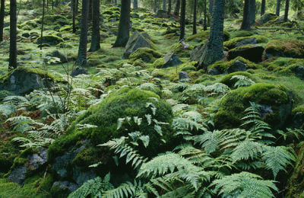
The reason we control certain variables is because they could affect our results.
In the example experiment, we used one species of plant. If we had used different species, any difference in growth could have been the result of one species being faster at growing than the other.
We would not have been able to determine if the difference in growth was caused by the different sunlight or the different species.

Slide 9
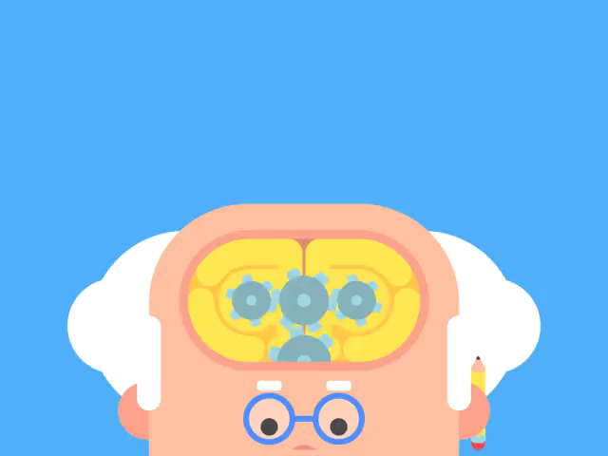
If you are having trouble telling what are the independent, dependent and control variables, look at it this way.
The dependent variable is your question.
(How quickly will the plants grow in shade versus sun?)
The independent variable is your method.
(To test this, I should place them in different levels of sunlight.)
Control variables are factors you do not want to think about.
(I do not care about how quickly different species grow.)

Slide 10
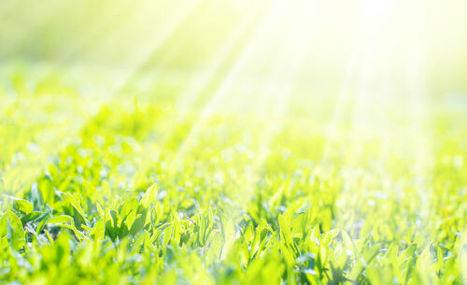
If you are still having trouble identifying independent and dependent variables, look for causes and effects.
In your experiment, there is a cause and an effect.
Because the sunlight is strong, the plants grew quickly.
The cause is the independent variable.
The effect is the dependent variable.

Slide 11
